Slide 1


Slide 2

Hospital Management System
By Mannan Rauf
Faraz Ul Abrar
Muhammad Osama Nusrat

Slide 3
Data Structure Implementation
Data Structures Used
Binary Trees
Linked List
Array
Note: Can be implemented by any other data structure but for best time complexity Big 0(nlogn)

Slide 4
Problem Statement
To provide step by step guidance to the incoming patients in the hospital for their treatment purposes.
Also deals with provision of health facilities for e.g. treatment by doctor, medicine etc

Slide 5

Procedure
A program that will guide you according to the needs.
State of patient
Registry of patient
Disease the patient is suffering from
Treatment by the Doctor
Medicines availability
Final bill

Slide 6
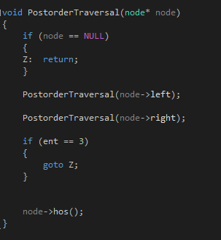
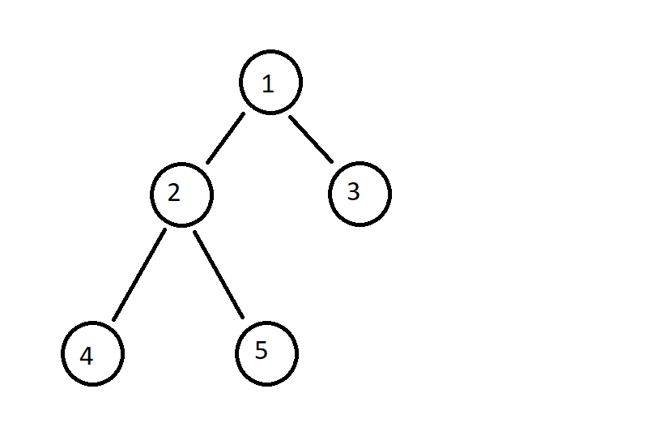
Code(Post order traversal)
Binary code implementation
Binary tree diagram of our code
Each node corresponds to a specific function

Slide 7
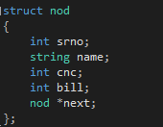
Linked list implementation
Linked list is used to store the data of each patient
Linked list is used as we have no clue about the number of patients, so memory is allocated dynamically
Each node contains the name of the patient, CNIC, bill for the patient and Serial number

Slide 8
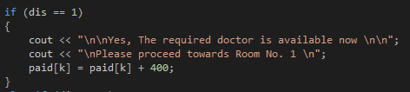

Array implementation
Array is used to update and store the bill for every patient
The bill consists of treatment charges and medicines
The array of bill for a patient is updated after a treatment and after a medicine is bought

Slide 9
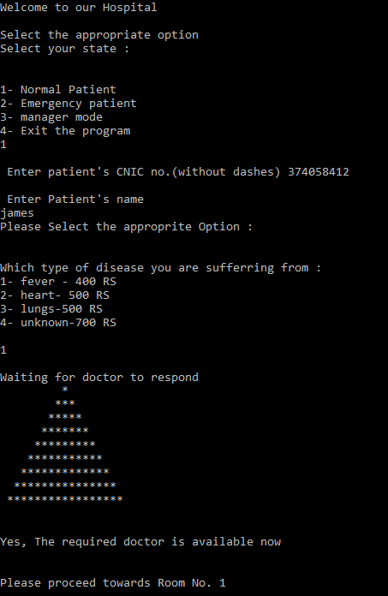
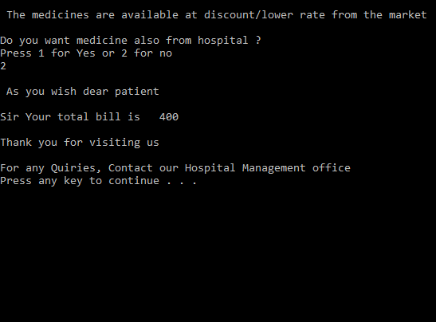

Slide 10
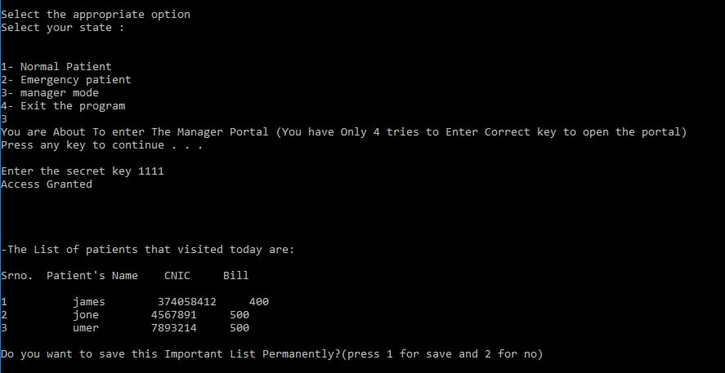

Slide 11
Display on output screen
Displays number of patients who visited the hospital
That day.
We used a display function void display()
Then we traversed the linked list from start to end by using while loop.
while (current != NULL)
{
cout << endl << current->srno << " " << current->name << " " << current->cnc << " " << current->bill;
current = current->next;
}

Slide 12
OOP Concepts
FILE HANDLING
We have used of file handling in it to save the data in the text file.
Included <fstream> library
Of stream: used to create files and write information.
If stream: used to read information from files
Fstream: can both write and read information from files
ofstream myfile;
myfile.open("HospitalSafe.txt");

Slide 13
To write something in a file we use << character.this is a syntax.
For eg
myfile << endl << "\n\n-The List of patients that visited today are:
This function is used to close the file
myfile.close();

Slide 14
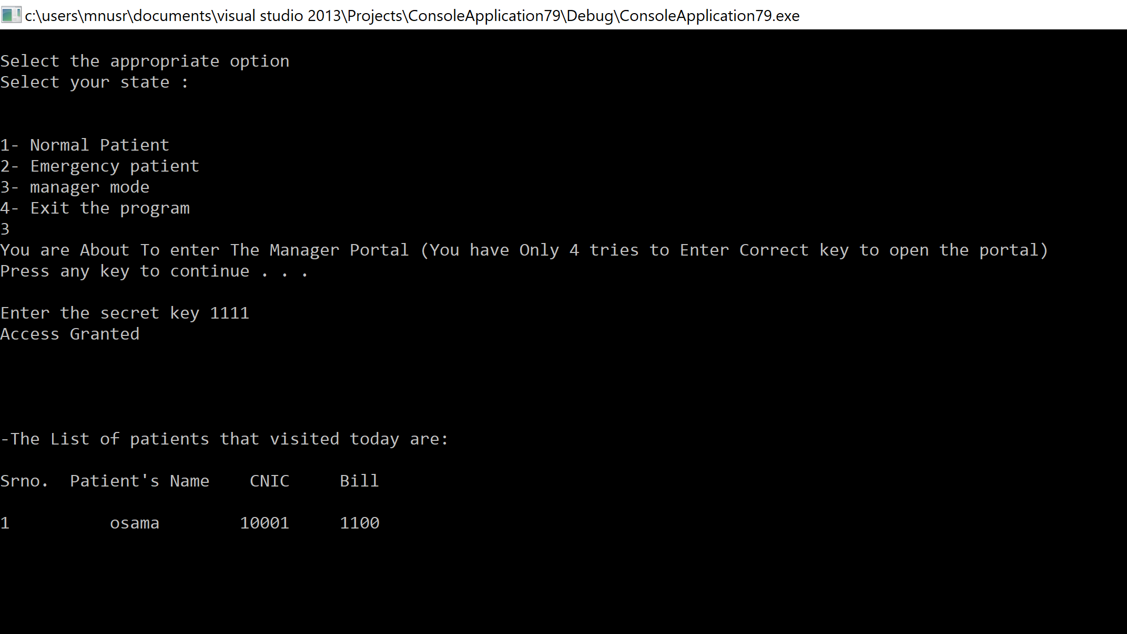

Slide 15
Manager Mode
This is restricted mode. only manager can access it with a secret pin number.
Only 4 tries are given
After 4 tries the program terminates
USE OF SLEEP FUNCTION
It Is used for time delay it can be 1 sec, 2 sec etc.
GOTO STATEMENT
It gives us a power to jump to any part of the program.

Slide 16


